Slide 1

NAMI: Navigational Autonomous Mapping Intelligence
A LIDAR-Based Autonomous Indoor Navigation System
PROJECT TYPE
Team
Vivek Prakash (2202161520117)
Ritik Pandey (2202161630079)
Major Project | Academic Year 2025-2026
CSE - AI (4th Year)
Course: BTECH
Submitted To: Mr. Ashish Jain

Slide 2




Challenges in Indoor Logistics
Addressing inefficiencies with dynamic, infrastructure-free autonomy.
Inefficient Manual Tasks
Traditional Automation Limits
Complexity and Rigidity
Time-consuming transport of files and goods.
Requires costly infrastructure (e.g., magnetic strips).
Difficult installation and configuration.
Staff diverted from core responsibilities.
Fixed paths; cannot handle moving obstacles.
Poor flexibility in changing layouts.
NAMI's Autonomous Solution
Infrastructure-Free Navigation
Real-Time Adaptation
Autonomous Operation
LIDAR-based system requires zero environmental modifications.
Dynamic obstacle detection and avoidance for flexible deployment.
24/7 reliability without continuous human intervention.

Slide 3
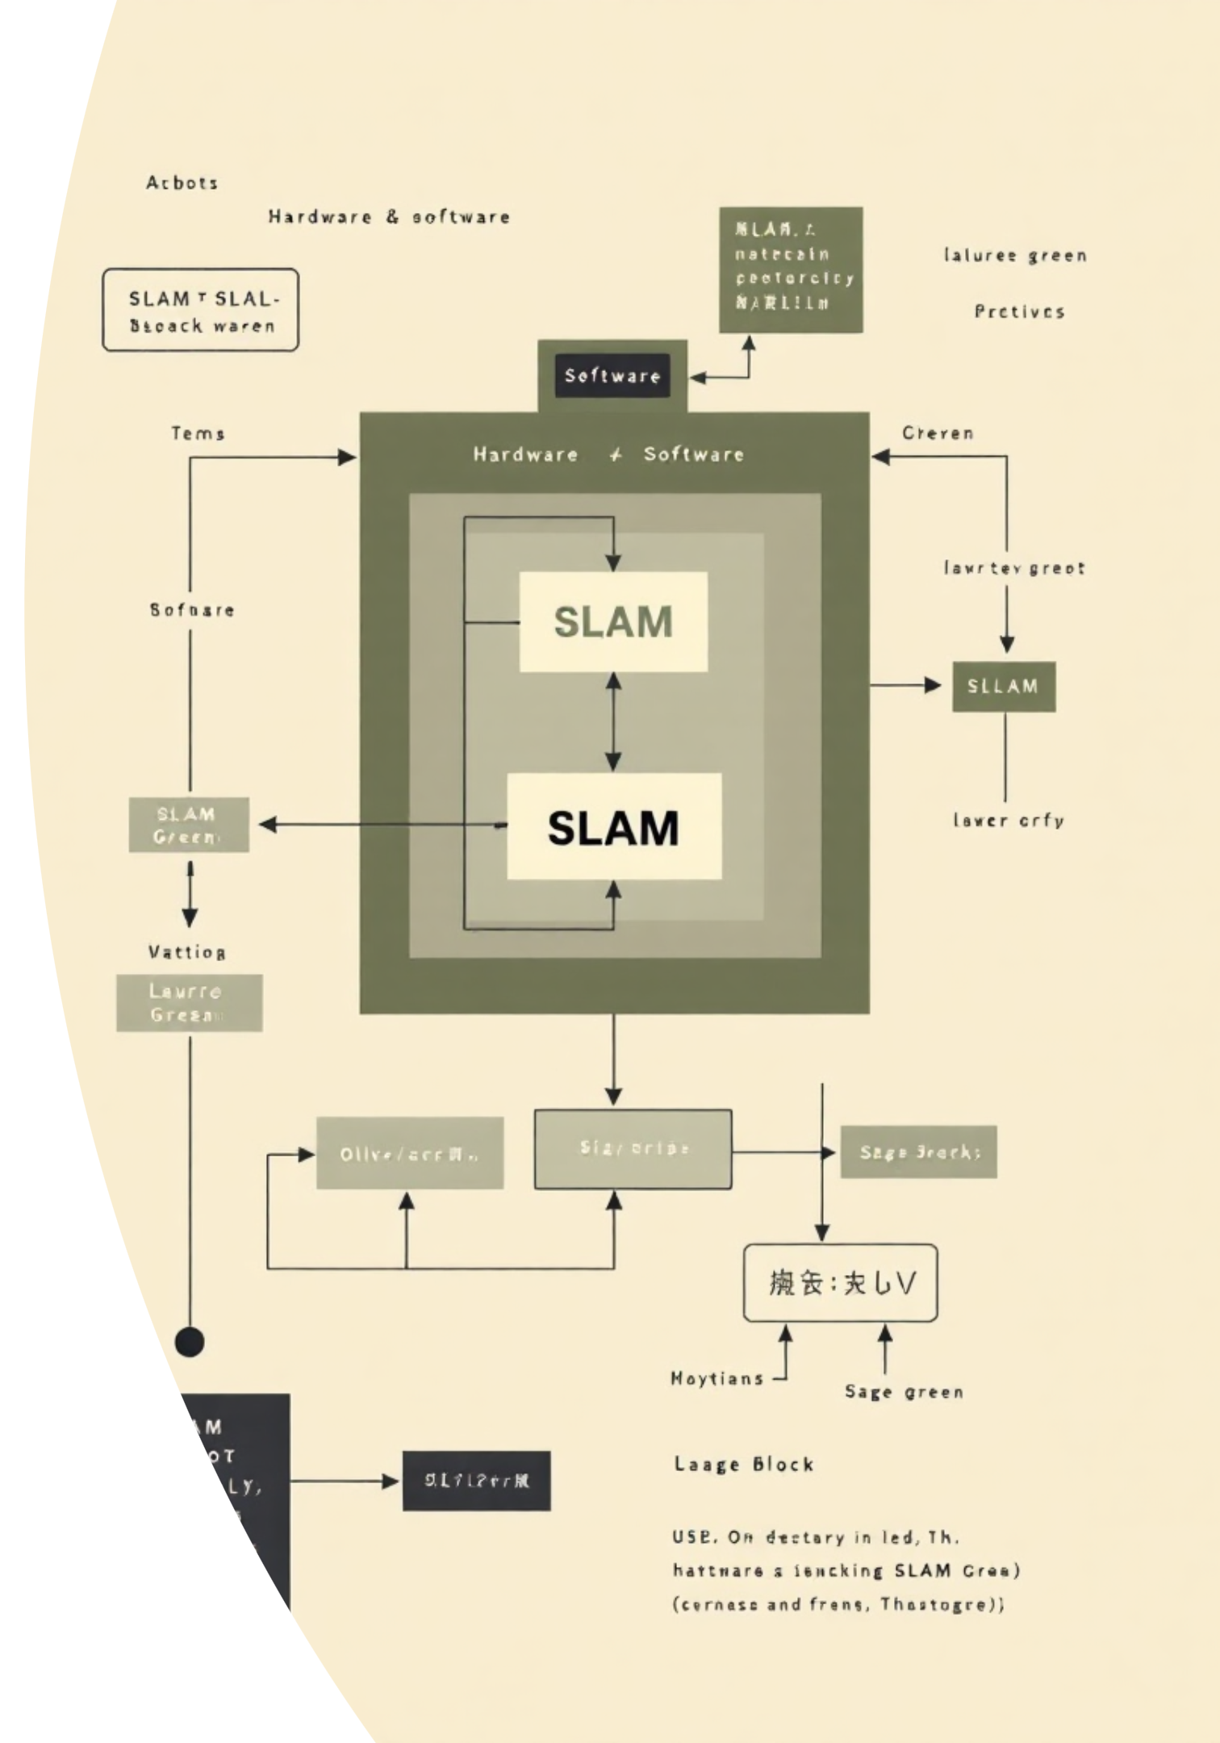





NAMI System Architecture
Integrating robust hardware with advanced SLAM algorithms.
Hardware Components
Software Architecture
LIDAR Sensor
2D/3D scanning (8-12m range, 360° coverage) for environmental input.
SLAM Algorithm
Particle Filter SLAM for simultaneous localization and mapping.
Raspberry Pi 4
High-performance unit for real-time SLAM processing and control.
Path Planning
Motor System
Dynamic route optimisation using the efficient A* algorithm.
Four DC motors with L298N drivers for precise omnidirectional movement.
Obstacle Avoidance
Safety & Power
Real-time path recalculation and dynamic collision mitigation.
Ultrasonic sensors for redundancy; 12V battery (6-8 hours operation).
Localization System
Continuous position tracking with high 5cm accuracy.

Slide 4
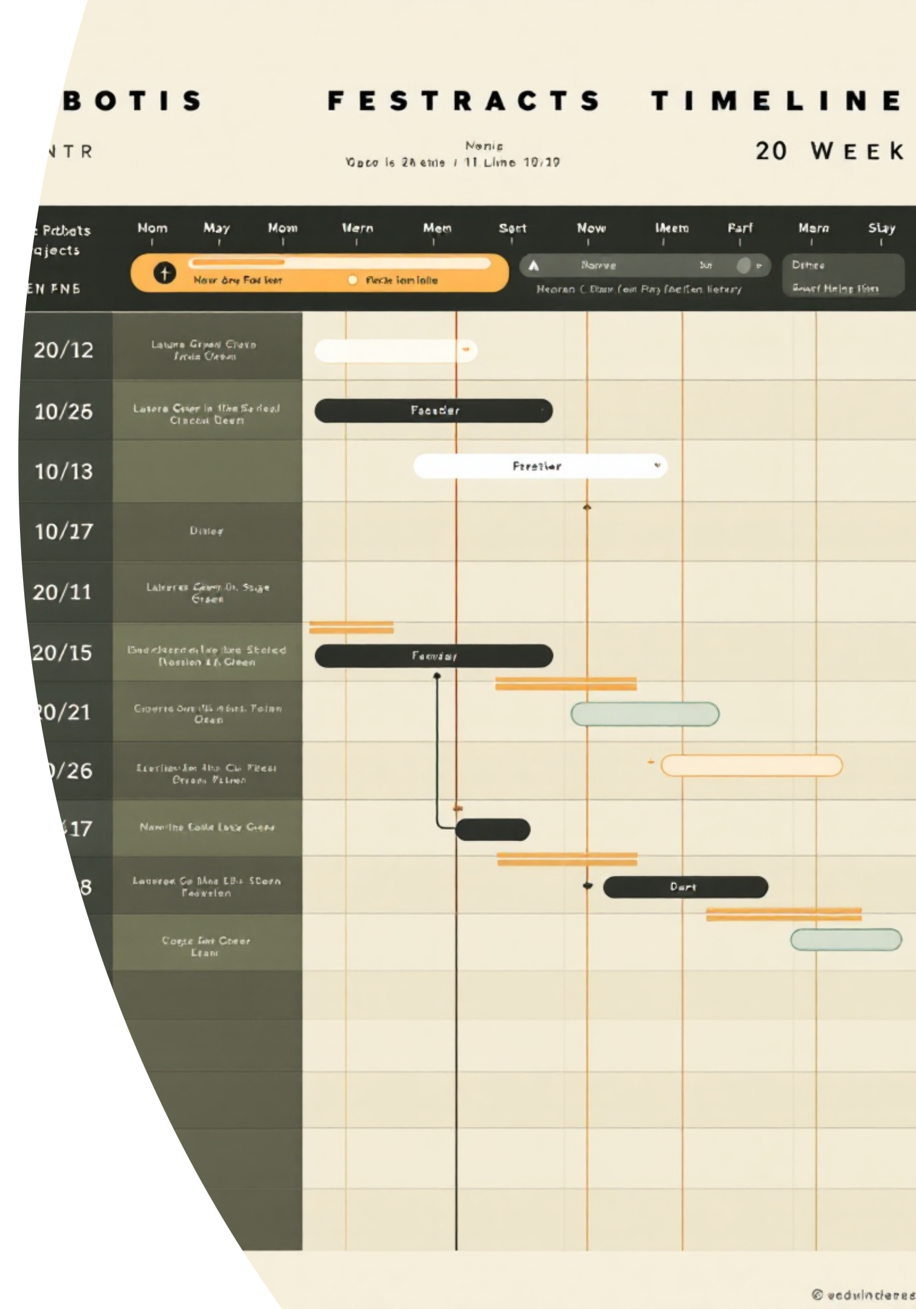
Implementation Methodology
Four-Phase Development Strategy
Phase 1: Environment Mapping
Weeks 1-5
LIDAR data collection and processing. SLAM algorithm used for 2D/3D map generation and validation.
Phase 2: Navigation System
Weeks 6-10
Localization, A* path planning, and motor control system calibration for movement execution.
Phase 3: Safety & Avoidance
Weeks 11-15
Dynamic obstacle tracking, collision avoidance algorithms, and multi-sensor fusion implemented.
Phase 4: Testing & Optimisation
Weeks 16-20
Real-world stress testing, parameter tuning, UI development, and final demonstration preparation.
This structured approach ensures robust integration, from initial point cloud data processing to final performance tuning.

Slide 5







Versatile Applications Across Industries
Healthcare Facilities
Corporate Offices
Medication, lab samples, patient file transport.
Document, mail, and office supply distribution.
Warehouses & Manufacturing
Hotels & Hospitality
Material transport and inventory movement.
Room service, luggage, and linen distribution.
Expected Impact & Future Enhancements
30%
5cm
Future Vision: Integrating advanced AI and multi-robot coordination.
AI-based predictive navigation and traffic learning.
Reduction in manual logistics workload.
High localization accuracy for precise navigation.
Multi-floor operation via elevator/door integration.
Swarm intelligence for coordinated robot fleets.
24/7
Continuous autonomous operation capability.

Slide 6

Revolutionising Indoor Mobility
NAMI offers a versatile, adaptable, and innovative platform leveraging LIDAR-SLAM technology.
Innovation
Adaptability
Infrastructure-free deployment across any indoor layout.
Real-time handling of dynamic obstacles and environments.
Efficiency
Automated logistics reducing human workload and operational costs.
Thank You
Questions and Discussion are Welcome

